Slide 1
Log4j2 + SLF4J
阿偉

Slide 2



重要發展
Log4j
LogBack
Log4j2
(效能最好)
2001-2015
2009-迄今
2015-迄今

Slide 3
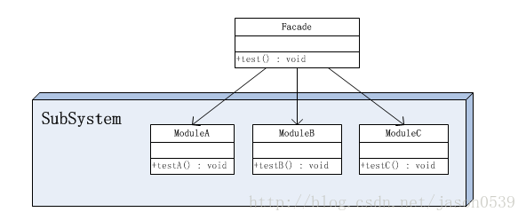
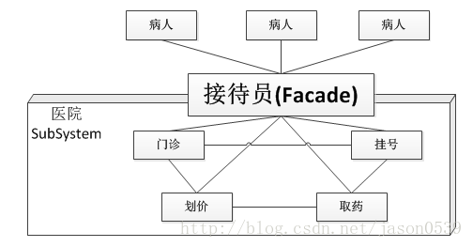
SLF4J (Simple Logging Facade for Java)
slfj4
log4j
org.apache.log4j.Logger.Logger.getLogger(Test.class);
log4j2
logback
org.apache.logging.log4j.LogManager.getLogger(Test.class);
ch.qos.logback.classic.LoggerContext.getLogger(Test.class);
(統一)
org.slf4j.LoggerFactory.getLogger(Test.class);

Slide 4

Log4j2 + SLF4J 相關依賴
pom.xml
<!-- SLF4J+LOG4J2-->
<dependency>
<groupId>org.apache.logging.log4j</groupId>
<artifactId>log4j-api</artifactId>
<version>2.7</version>
</dependency>
<dependency>
<groupId>org.apache.logging.log4j</groupId>
<artifactId>log4j-core</artifactId>
<version>2.7</version>
</dependency>
<dependency>
<groupId>org.apache.logging.log4j</groupId>
<artifactId>log4j-slf4j-impl</artifactId>
<version>2.7</version>
</dependency>

Slide 5
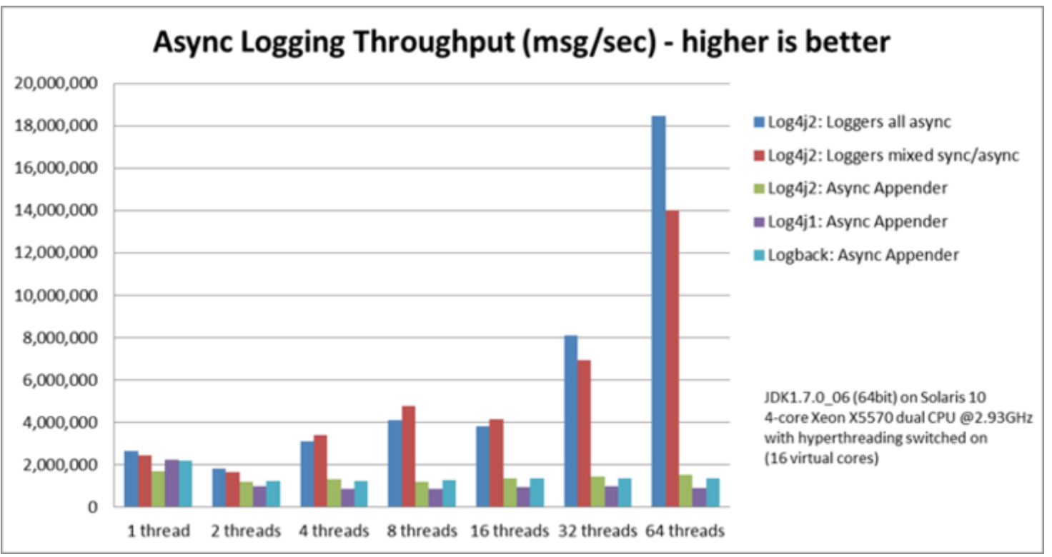
為什麼要推 Log4j2？
更簡化的配置
更強大的參數格式化
最誇張的異步性能
資訊安全

Slide 6
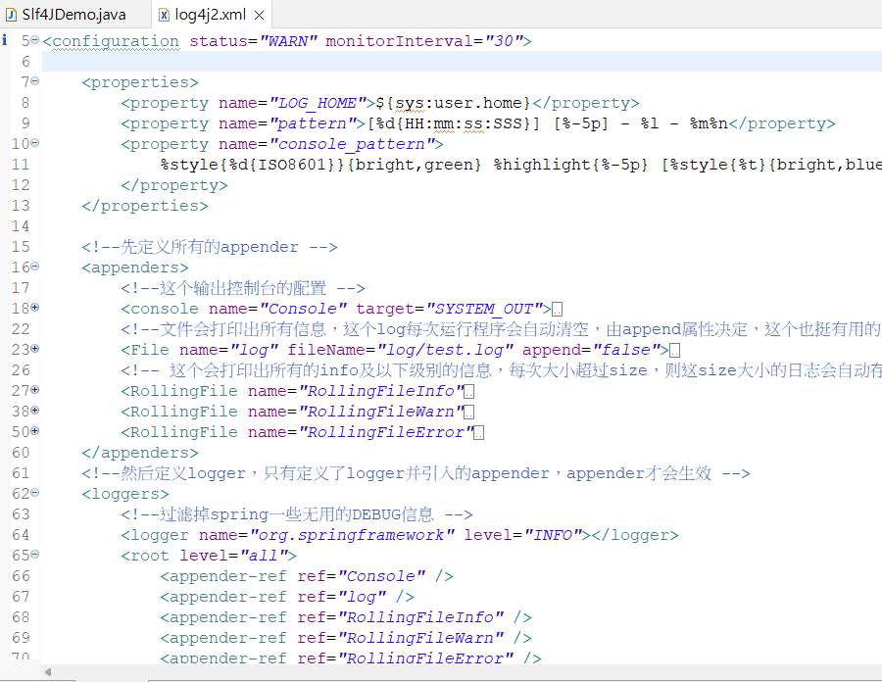
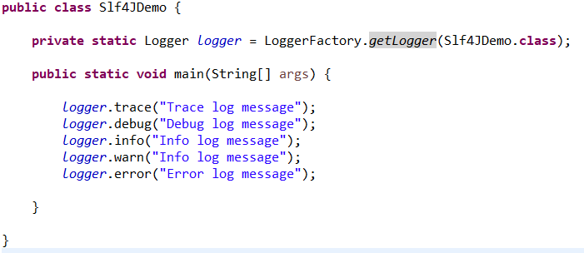
配置檔+如何記錄Log
resources/log4j2.xml

Slide 7
參考資料
带你深入Java Log框架，彻底搞懂Log4J、Log4J2、LogBack，SLF4J https://cloud.tencent.com/developer/article/2347147
JAVA设计模式之门面模式（外观模式）https://www.runoob.com/w3cnote/facade-pattern-3.html
Log4j2官方中文文檔：https://www.docs4dev.com/docs/zh/log4j2/2.x/all/manual-index.html

